Slide 1

Predicting customer buying behavior
28/07/2023

Slide 2
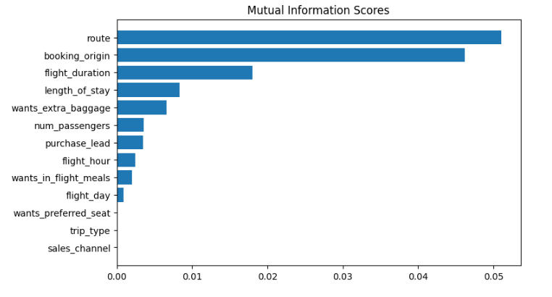
predictive model to understand factors that influence buying behavior
We have trained the dataset with XGBoost Model and received
Accuracy: 84.87
AUC Score: 0.5
route
booking_origin
flight_duration
wants_extra_baggage
length_of_stay
are the top 5 features which influence
Customer buying behavior

